Slide 1
M Tech(Data Science & Engineering) Introduction to Statistical Methods [ISM]

Slide 2
Session No 5
Random Variables & Probability Distributions
(Session 5: 4th /5th June ,2022)

Slide 3
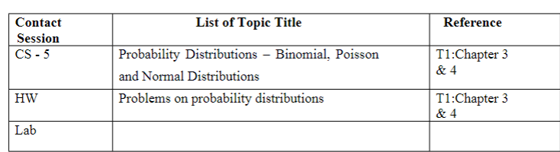
Session No 5 Course Handout

Slide 4
Agenda
Probability Distributions
Bernoulli
Binomial
Poisson
Normal

Slide 5
Probability Distributions

Slide 6
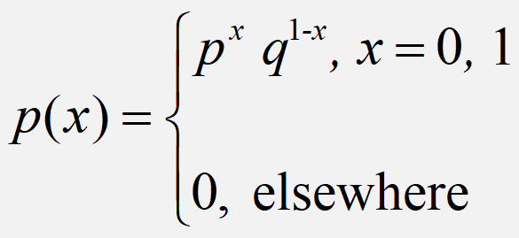
Bernoulli Distribution
A random variable ‘X’ is said to have
Bernouli distribution if its probability mass
function is given by
Definition

Slide 7

Mean & Variance

Slide 8
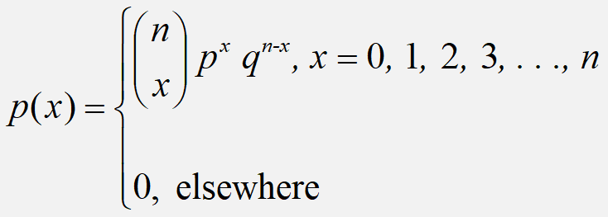
Binomial Distribution
A random variable ‘X’ is said to have
Binomial distribution if its probability mass
function is given by
Definition

Slide 9
Definition
A random variable X is said to follow binomial distribution if it assumes only non negative values and its probability mass function is given by
P [X= x] = f(x) = nC_{X}p^{X}q^{n-x} ; x= 0, 1,2,…..n
= 0 ; otherwise
n and p are two parameters of the distribution and q = 1-p

Slide 10
Binomial Distribution
Binomial distribution is a discrete probability distribution.
Binomial distribution will be applied under the following experimental conditions
1) The number of trails (n) is finite
2) The trails are independent of each other
3) The probability of success p is constant for each trail.
4) Each trail results in two mutually exclusive events known as success and failure.

Slide 11
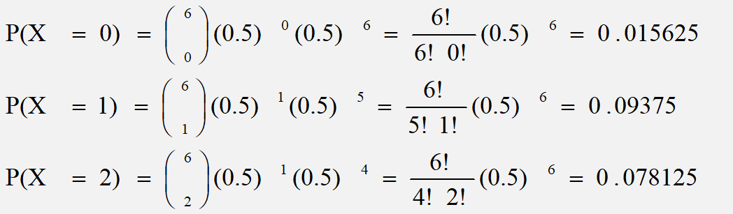
Binomial Distribution
If a coin is tossed 6 times, what is the probability of getting 2 or fewer heads?
P(x ≤ 2) = ∑p(x) = 0.015625 + 0.09375 + 0.078125 = 0.1875

Slide 12
Example
The probability that a man aged 60 years will remain alive till 70 is 0.65.
What is the probability that out of 10 such men at least 7 would be alive at 70?

Slide 13
Solution

Slide 14
Example
Nationalized bank sanctions short term loan for its customers. The probability of sanctioning loan by the bank is 0.53. If 5 persons are selected at random what is the probability that
a) none were sanctioned loan?
b) between 1 to 4 were sanctioned the loan?
c) more than 3 were sanctioned the loan?

Slide 15
Mean & variance

Slide 16




Slide 17
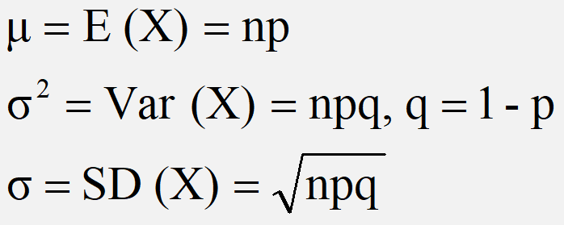
Binomial Distribution
All probability distributions are characterized by an
expected value and a variance
If X follows a binomial distribution with parameters n and p then we write X ~ B(n, p)
Note: the variance will always lie between
0*n - 0.25 *n
p(1 - p) reaches maximum at p=0.5
p(1 - p)=.025

Slide 18
Practice Problems
An unbiased dice is thrown 5 times and occurrence of 1 or 6 considered as success find,
Probability of exactly one success
Probability of at least 4 success
Probability of at least one success
Mean and variance
The probability that a bomb dropped from a plane will strike the target is 1/5. if six such bombs are dropped. Find the probability that
1) exactly two bombs hit the target
2) At least two will hit the target

Slide 19
Practice Problems
1. With usual notation find p of binomial distribution if n=6
9P(x=4)=P(x=2)
2.
Find the binomial distribution if the mean is 4 and variance is 3

Slide 20
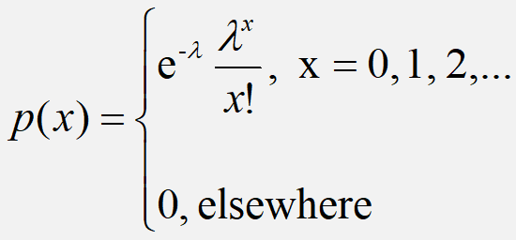
Poisson Distribution
A random variable ‘X’ is said to have
Poisson distribution if its probability mass
function is given by
Definition
Poisson distribution is the discrete probability distribution of a discrete random variable X, which has no upper bound. It is defined for non negative values of x as follows

Slide 21
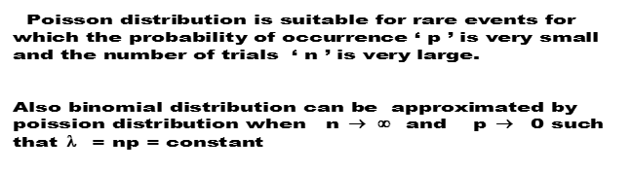
Cont…

Slide 22
Poisson distribution

Slide 23




Slide 24
Example
If the probability of a bad reaction from a certain injection is 0.001.
Determine the chance that out of 2000 individuals more than two will get a bad reaction.

Slide 25
Solution

Slide 26
Poisson Distribution
Police records show that number of accident victims died in road traffic accidents is 0.1%. What is the probability that among 500 randomly selected accident victims
(i) none have died?
(ii) at least 3 have died
(iii) between 2 and 6 have died

Slide 27
Poisson Distribution
A car hire firm has two cars which it hires out day by day. The number of demands for a car on each day is distributed as Poisson variate with mean is 1.5. calculate the probability that
Neither a car is used
Some demand is refused

Slide 29
Practice Problems
A hospital switch board receives an average of 4 emergency calls in a 10 mins interval, what is the probability that
There are 2 emergency calls
There are 3 emergency calls in an interval of 10 mins
If a random variable x follows Poisson distribution such that
P(x=1)=2P(x=2), find the mean and variance of the distribution

Slide 30
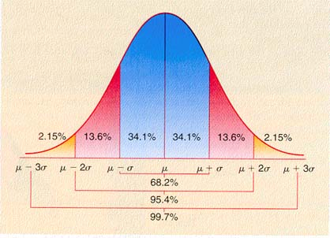
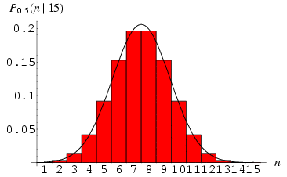
Normal Distribution
Change in Mean determines the shift in the distribution
Change in the deviation determines the spread of the data points
μ = mean
σ = standard deviation
π = 3.14159
e = 2.71828
This is a bell shaped curve with different centers and spreads depending on μ and σ
Notes:
RV is a Non-Negative Integer starting from 0.

Slide 31
Normal Distribution
f(X)
Changing μ shifts the distribution left or right.
Changing σ increases or decreases the spread.
σ
μ
X
Properties:
1. Normal curve is bell shaped and symmetric about the mean
2. Mean = Mode = Median
3. Total area under normal curve is equal to 1
4. Normal curve approaches but never touches the x axis as it extends farther and farther away from the mean

Slide 32
Normal Distribution
E(X)=μ =
Var(X)=σ² =
Standard Deviation(X)=σ
No matter what μ and σ are, the area between μ-σ and μ+σ is about 68%; the area between μ-2σ and μ+2σ is about 95%; and the area between μ-3σ and μ+3σ is about 99.7%. Almost all values fall within 3 standard deviations.

Slide 33
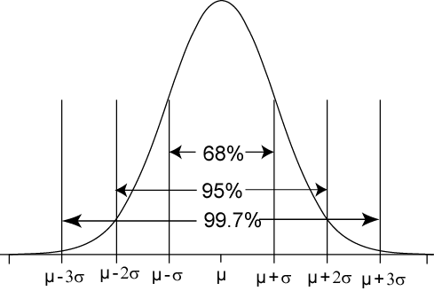
68-95-99.7 Rule for Normal Distributions
68% of the AUC(Area under curve) within ±1σ of μ
95% of the AUC within ±2σ of μ
99.7% of the AUC within ±3σ of μ

Slide 34
Standard Normal Distribution
The standard normal distribution is a normal distribution with a mean of 0 and a standard deviation of 1.
z
−3
−2
−1
0
1
2
3
All normal distributions can be converted into the standard normal curve by subtracting the mean and dividing by the standard deviation

Slide 35
Example:
The average on a statistics test was 78 with a standard deviation of 8. If the test scores are normally distributed, find the probability that a student receives a test score less than 90.
μ = 78
σ = 8
P(x < 90)
The probability that a student receives a test score less than 90 is 0.9332.
x
μ =78
90
P(x < 90) = P(z < 1.5) = 0.9332

Slide 36
Example:
The average on a statistics test was 78 with a standard deviation of 8. If the test scores are normally distributed, find the probability that a student receives a test score greater than than 85.
μ = 78
σ = 8
P(x > 85)
The probability that a student receives a test score greater than 85 is 0.1894.
x
μ =78
85
P(x > 85) = P(z > 0.88) = 0.1894

Slide 37
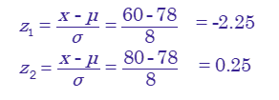
Example:
The average on a statistics test was 78 with a standard deviation of 8. If the test scores are normally distributed, find the probability that a student receives a test score between 60 and 80.
P(60 < x < 80)
μ = 78
σ = 8
x
The probability that a student receives a test score between 60 and 80 is 0.5865.
60
μ =78
80
P(60 < x < 80) = P(−2.25 < z < 0.25) =
0.5865

Slide 42
Problem 5.25(Page 150)
The time for oil to percolate to all parts of an engine can be
treated as a random variable having a normal distribution
with mean 20 seconds. Find its standard deviation if the
probability is 0.25 that will take a value greater than 31.5
seconds.
Given : Mean μ = 20 seconds, P(X > 31.5) = 0.25
σ = ?

Slide 43
Problem 5.26(Page 150)
Butterfly-style valves used in heating and ventilating
industries have a high flow coefficient. Flow coefficient can
be modeled by a normal distribution with mean 496 C_{v} and
standard deviation 25C_{v}. Find the probability that a valve
will have a flow coefficient of
atleast 450C_{v}
P(X > 450) = P[( 450 – 496) /25] = P(Z > -1.84) =
b) between 445.5 and 522C_{v}
P(445.5 <X <522) = P(-2.02 <Z <1.04) =

Slide 44
Practice Problems
In an intelligence test administered to 1000 students, the average was 42 and standard deviation was 24. find the number of students
Exceeding the score 50
Between 30 and 54

Slide 45
Practice Problems
Monthly salary X in a big organization is normally distributed with mean Rs 3000 and standard deviation of Rs 250.
What should be the minimum salary of a worker in this organization so that the probability that he belongs to top 5% workers?

Slide 46
Thanks

